Slide 1
Grievance Reporting and Addressing System
Student registration number: 076431
Supervisor: Conrad Ojiambo

Slide 2
Background
Governments are put in place to govern the citizens in their area(s) of jurisdiction.
More than this, though, governments are charged with the responsibility of providing solutions to the various problems that their citizens may encounter.
Governments can only do this if they have a way of knowing what issues these are that the citizens are facing.

Slide 3
Background
At present-on a small scale- there exist suggestion boxes through which people can channel their sentiments to the authorities.
At a country level scale, it becomes exponentially difficult to deal with suggestion boxes; from having them in place, citizens getting to where they are and dropping their issues inside, government officials going round emptying the boxes then reading through each submission and to some extent, vandalism.
This is time and resource-consuming, and leads to inefficiencies in the way governments perform their tasks

Slide 4
Problem Statement
At present, there isn’t an efficient or effective way through which issues can be channeled to the relevant authorities for addressing, neither is there a means through which the authorities can effectively address the issues being faced

Slide 5
Aim
To develop a system through which citizens can channel their issues/problems/suggestions to their government, and to have a means through which governments can be made aware of these issues, so as to be better placed to effectively and efficiently address them.

Slide 6
System Analysis
Functional requirements
Non-Functional Requirements
Use Case-Description and Diagram

Slide 7
System Analysis
Functional Requirements
These describe the functioning of the system

Slide 8
System Analysis
Functional Requirements
Users should be able to create new accounts; through which they will access the system
Users will be able to log in to the system with their registered accounts
(Citizen) users will be able to make posts on the system(issues, concerns, problems)
Users will be able to view posts made by other users, as well as make comments and upvote

Slide 9
System Analysis
Functional Requirements
The Government user(s) will be able to sign into the system as an administrator
The government user will be able to view posts made by citizen users, as well as comment on them
The government user will be able to view analytics generated from the user generated posts

Slide 10
System Analysis
Non-Functional Requirements
These are a description of how the system should be, together with the criteria that can be used to judge the operation of the software

Slide 11
System Analysis
Non-Functional Requirements
Product Requirements
The system should be available to use at any time of the day.
Security Requirements
The users must each have a username and password to grant them access.
Operational Requirements
The system must be accessible from a wide range of internet browser applications.

Slide 12
System Analysis
Use-case Narrative, Description, Diagram

Slide 13










System Analysis
Use-case Narrative

Slide 14
System Analysis
Use-case Diagram

Slide 15
System Design
(Enhanced) Entity Relationship Diagram
Sequence Diagram
Class Diagram
Database Schema
Sample User Interfaces

Slide 16
System Design
(Enhanced) Entity Relationship Diagram

Slide 17
System Design
Sequence Diagram

Slide 18
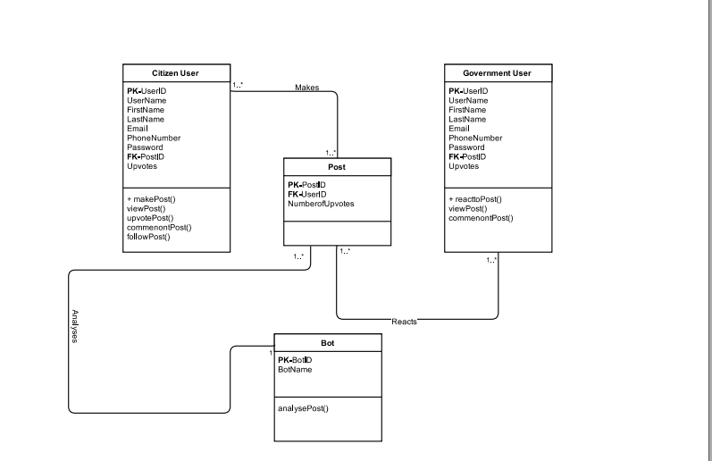
System Design
Class Diagram

Slide 19
System Design
Database Schema

Slide 20
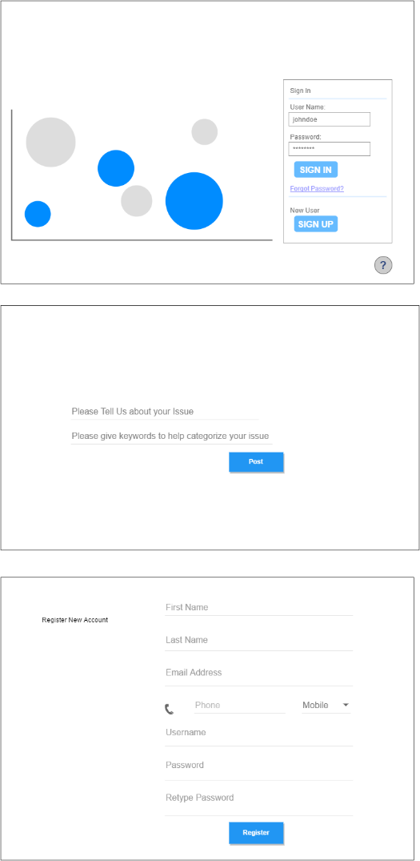
Sample User Interfaces

Slide 21
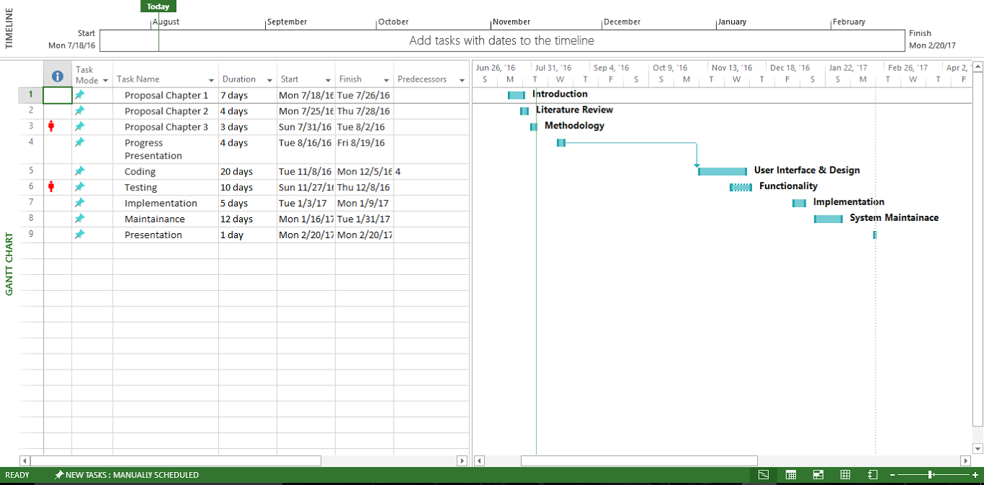
Gantt Chart

